Slide 1

Good judgment Project and the Contribution weighted model
Eva Chen
Shrinidhi Lakshmikanth, David Budescu, Barbara Mellers and Phil Tetlock

Slide 2
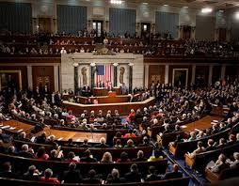
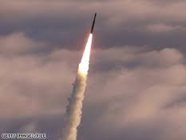

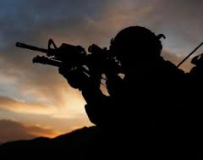
Harnessing the wisdom of the crowd to forecast world events
IARPA created the ACE Program to dramatically enhance the accuracy, precision, and timeliness of intelligence forecasts
Development of advanced techniques that elicit, weight, and combine judgments
Five university-based teams enter the 2011-2015 tournament (GJP eliminated the other 4 teams after the second year)
Each team submitted forecasts each day for each question, using methods of its choice
IARPA has posed over 500 questions for the last 4 years:

Slide 3
Wisdom of the crowd
Collective intelligence
  Average responses
  Diminish individual errors
  Knowledgeable and diverse
  Better than or equal to:
    Average individual
    Randomly selected individual
Sir Francis Galton’s ox
Truth
# of
Judges
Weight of ox
(a)
(b)
(c)
Adapted from: Larrick, Mannes and Soll (2012)

Slide 4
Aggregation of judgment
Methods for aggregation
  Behavioral (e.g., jury and committee)
  Markets (e.g., prediction markets)
  Mathematical
    Bayesian models
    Weighting models
Bases for weights
  Past performance
  Test performance (Cooke)

Slide 5
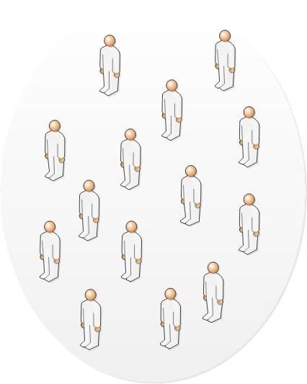
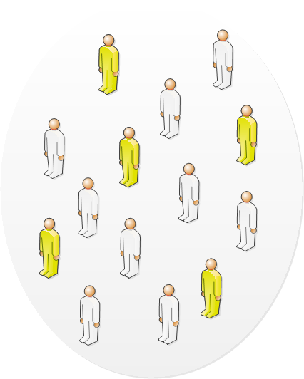
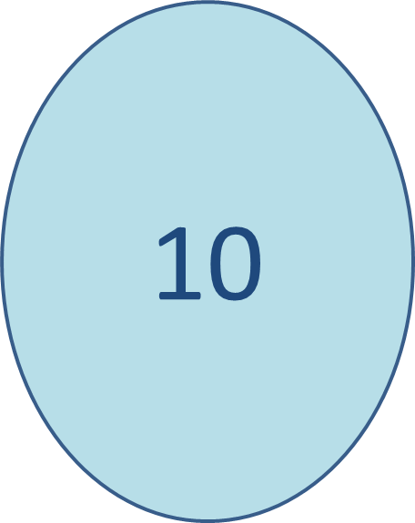

Identifying experts
Contribution:
Measure the expertise that the judge brings to the group.
Aggregation of judge’s impact on the group performance (Score) across all items (i).
9
Contribution: 10 - 9 = 1

Slide 6
The Aggregation Model
Group’s aggregate forecast:
P_{Git} = A (P_{jit})
Forecast of judge (j) for event (i) at time (t)
Aggregation function
P_{(G - j)it}
Re-calculate the group’s forecast, excluding j:
Merit score of the group :
S_{Git} = f (P_{Git})
Merit function (e.g. Brier score)
Judge’s contribution to the group item i at time t:
C_{jit} = S_{Git} - S_{(G - j)it}
Judge’s average contribution :
C_{jt} = Σ C_{ijt} / I_{j}
All I_{j} items j answers at t
C_{jt,}
  reflect the relative expertise of the various judges in the context of the group
  can be positive, negative or 0
  can vary over time as more items are being forecasted

Slide 7
Contribution Weighted Model
Budescu and Chen (2015) proposed using a weighted aggregate of all positive contributors.
  w_{jt}, are scaled such that all w_{jt} ≥ 0, and Σ w_{jt} = 1.
  P_{Gi(t + 1) =} A(w_{jt}, P_{ji(t + 1)}) for item i at time (t+1)
CWM model:
  weights are proportional to the contribution scores
  only judges with positive contributions are used.
  w_{jt} = 0 if C_{jt} ≤ 0, and w_{jt} = (C_{jt} / ΣC_{jt} ) if C_{jt} > 0.

Slide 8
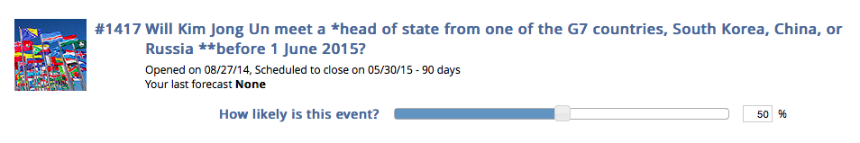
Study 1: Geo-political forecasting tournament
Binary
Ordered multinomial
Unordered multinomial
Conditional
Item/event
Probabilistic judgment

Slide 9
Experimental design
Expertise (training & teaming)
Facilitation (professional coaches)
Period1 | No Training | Training
Individual | Ind-NT (157) | Ind-T (148)
Team | Team-NT (123) | Team-T (96)
Period 2 | No Training | Training | Facilitation
Individual | Ind-NT (116) | Ind-T (105)
Team |  | Team-NF (126) | Team-F (80)

Slide 10
Data collection
Data from Jun’12-Jun’13 and from Jun’13-Jun’14
Collect forecasts from voluntary judges.
Items from international business, economy, military, policy, politics, etc.
Judges answer items based on their interest (about 20% of items). We use those who answered ≥ 20 items
Score (0-100), where 75 score = 0.5 probability

Slide 11
CWM compare to alternative models
Models | Description
UWM | Unweighted mean of judges with 20 or more items
BWM | Weighted mean based on past Scores of judges who answered at least 20 items
BWM was cross-validated.

Slide 12
CWM beats all models in Period 1

Slide 13
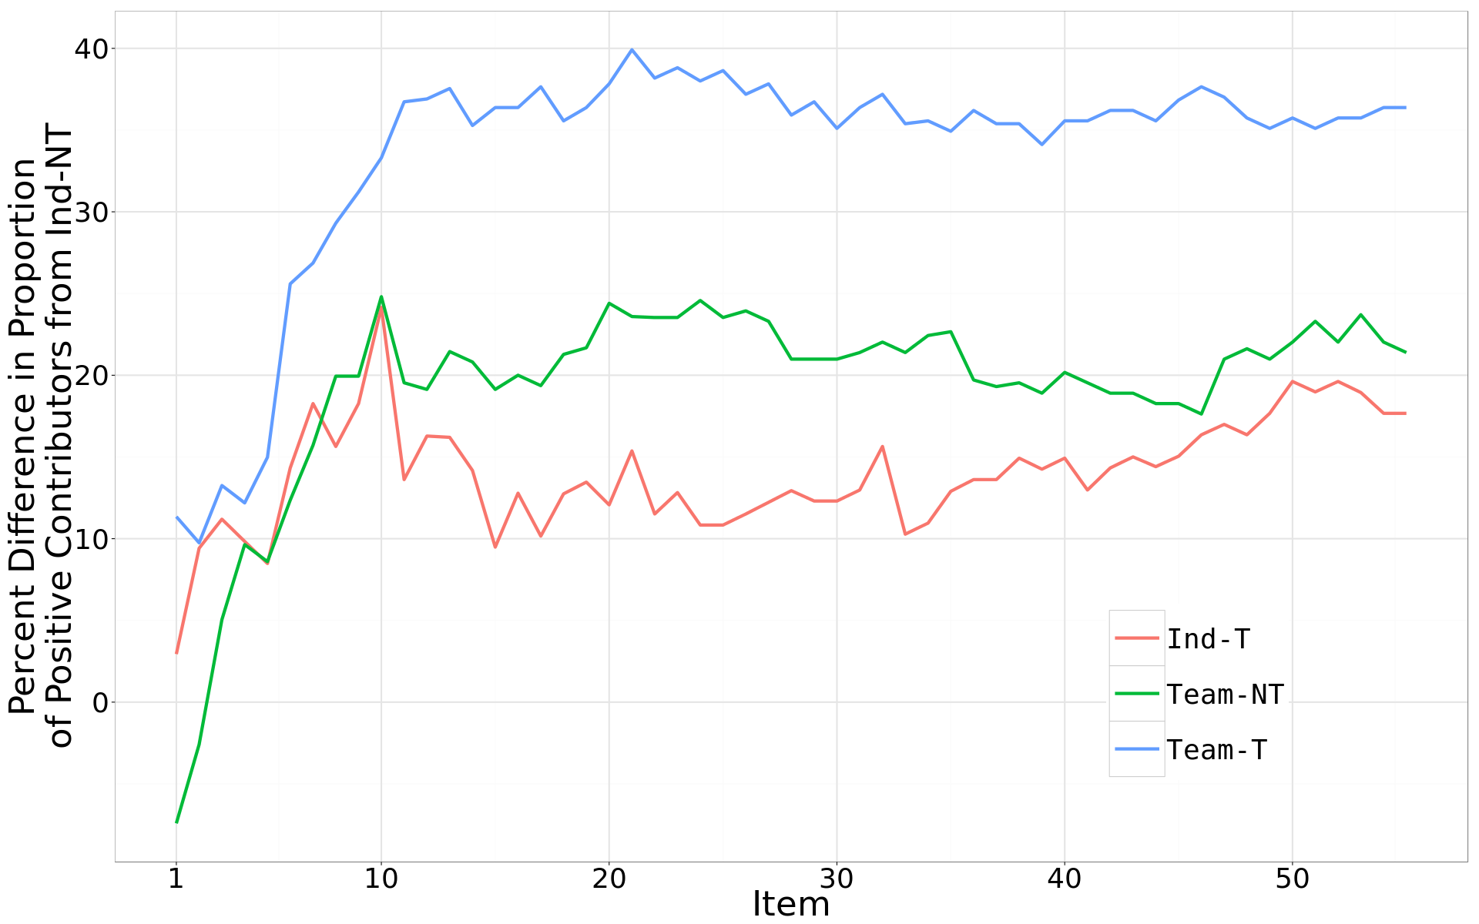
Effect of training and team

Slide 14
CWM beats all models in Period 2

Slide 15
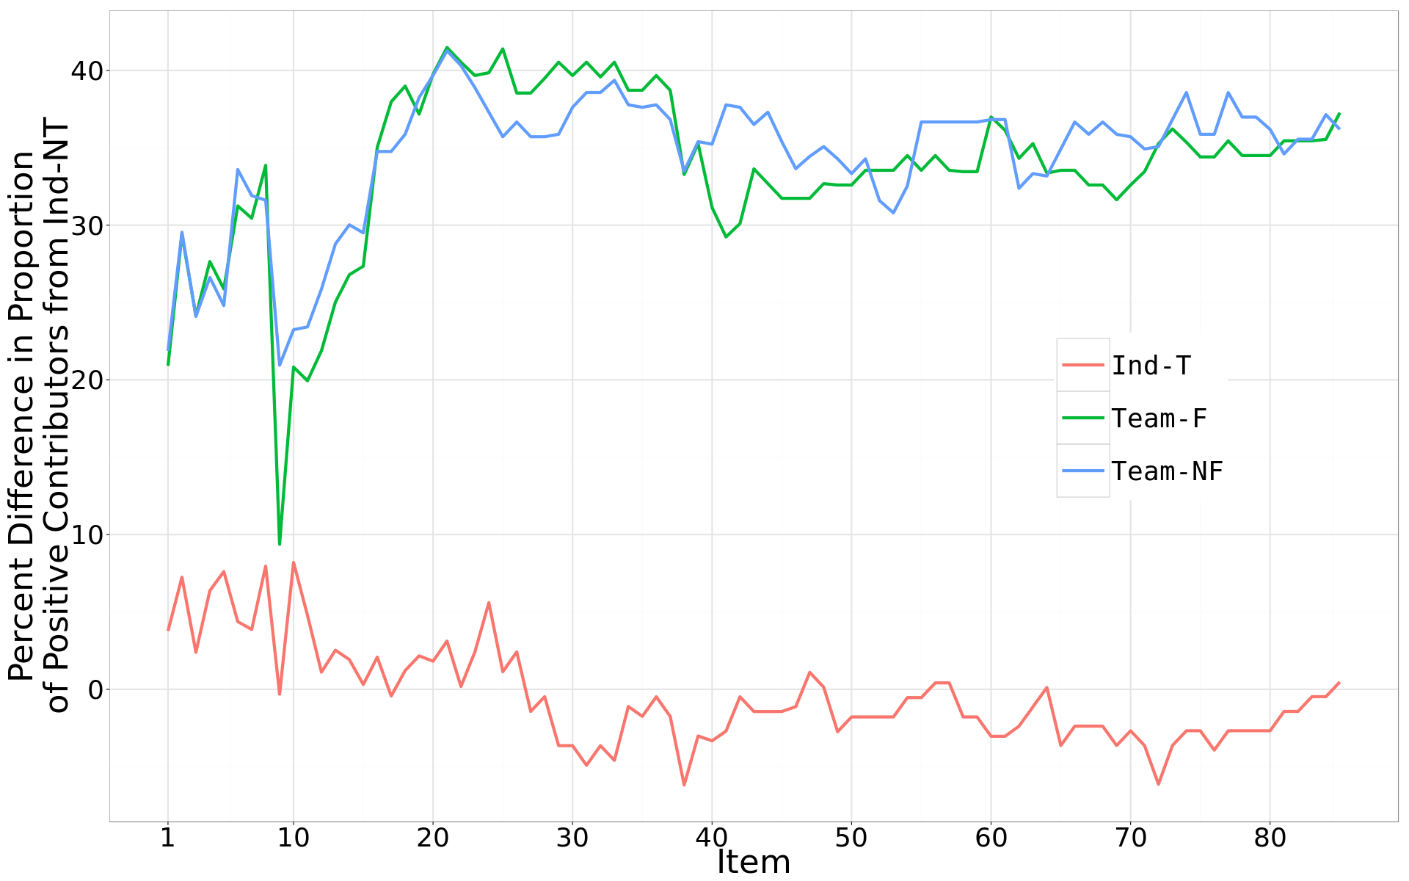
Effect of facilitation

Slide 16
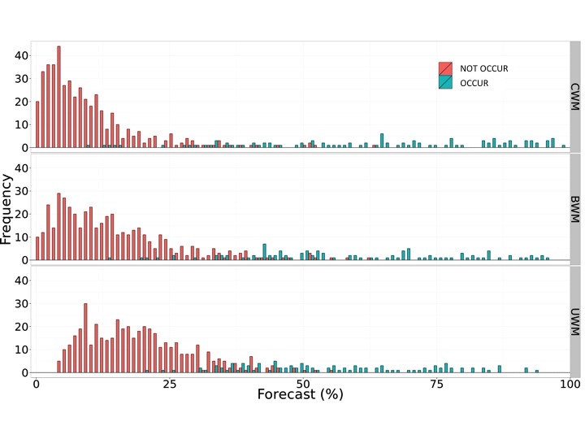
Discrimination

Slide 17
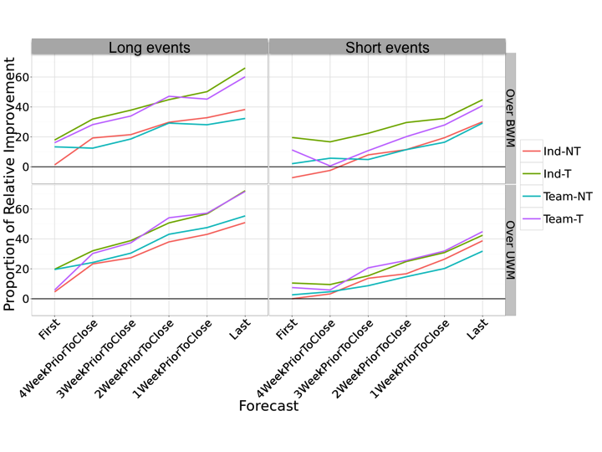
Effect of time

Slide 18
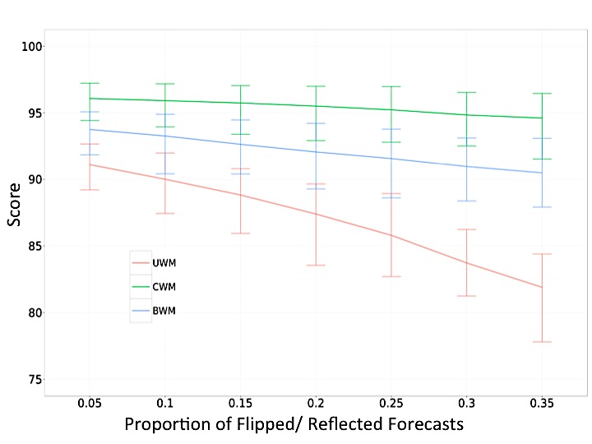
Robustness: Dishonest forecasters
* 50 run simulations using Teams form Period 1

Slide 19
Cost benefit analysis
Cost function= Items (I) * Judges(J) * Cost (C)
Experts are costly
Training questions require time
Maintain accuracy level
Two scenarios (Ind-T from Period 2, to predict 36 items):
Reduce cost by eliminating less contributing judges
Reduce cost by randomly eliminating judges
Reduce Cost function = (p + (1-p)w) I J C
(subset J, w, where 0 < w < 1)
(subset I, p, where 0 < p < 1)

Slide 20
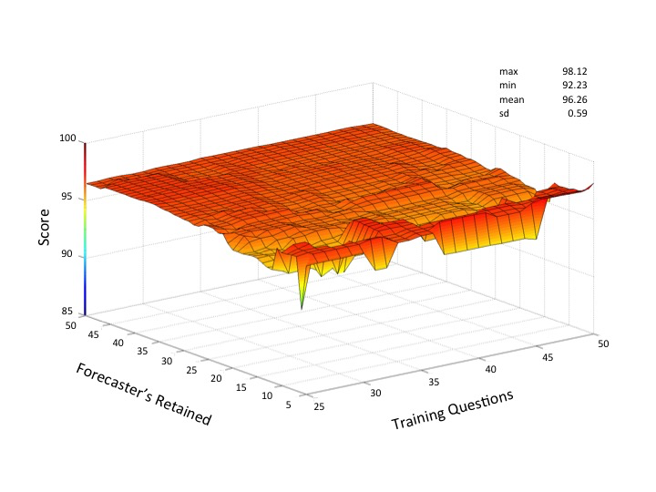
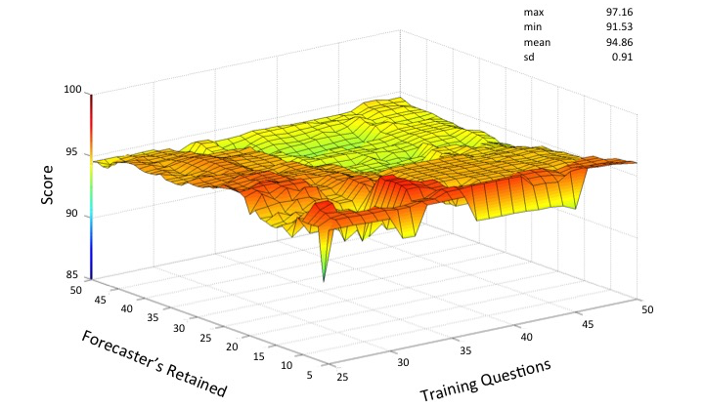
Cost benefit analysis with top contributors
CWM:
Top 20 contributors
25 practice questions
57% saving => 95.29 Score
CWM vs. BWM:
PRI: 27.22% better than BWM
SD_{cwm}: 0.59
SD_{bwm}: 0.91

Slide 21
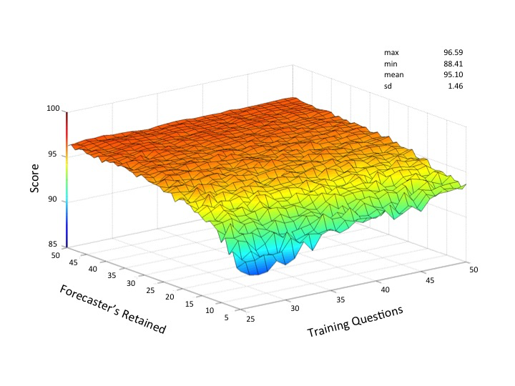
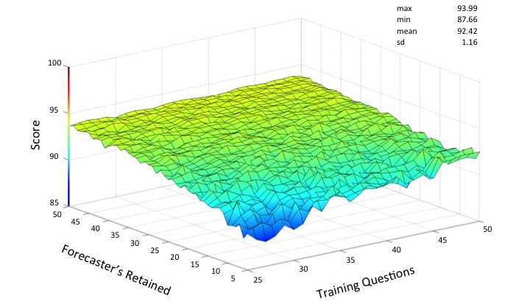
Cost benefit analysis with random forecasters
CWM:
15 contributors
40 practice questions
46% saving => 93.97 Score
* 50 run simulations

Slide 22
Summary of contribution
Measure of contribution is simple, reliable and useful for assessing forecaster’s performance.
CWM is a better weighting tool in the aggregation process than those built solely on past, individual performance (BWM).
=> weighting people who have knowledge against the crowd
CWM works best when there is expertise in the crowd: training or teaming
CWM is robust (time, length of items and dishonest forecasters).
CWM can reduce the cost of expert judgment.

Slide 23
www.goodjudgmentproject.com
Budescu, D.V. & Chen, E. (2015). Identifying expertise to extract the Wisdom of Crowds. Management Science, 61(2), 267-280.
This work was supported, in part, by the Intelligence Advanced Research Projects Activity (IARPA) via Department of Interior National Business Center.

