Slide 1
Adversarial Risk Analysis for Urban Security
Jesus Rios, IBM Research
David Rios, Cesar Gil, D. Banks

Slide 2
Outline
Adversarial Risk Analysis
The sequential Defend-Attack-Defend Model
Urban security resource allocation problem
Discussion

Slide 3
Adversarial Risk Analysis
A framework to manage risks from actions of intelligent adversaries
One-sided prescriptive support
  Use a SEU model
  Treat the adversary’s decision as uncertainties
New method to predict adversary’s actions
  We assume the adversary is an expected utility maximizer
    Model his decision problem
    Assess his probabilities and utilities
    Find his action of maximum expected utility
  But other descriptive models are possible
Uncertainty in the Attacker’s decision stems from
  our uncertainty about his probabilities and utilities

Slide 4
Defend–Attack–Defend model
Two intelligent players
  Defender
  Attacker
Sequential moves
  Defender moves first, deploying defense resources
  Attacker observes Defender’s move and choose an attack
  Defender moves again responding to the attack

Slide 5
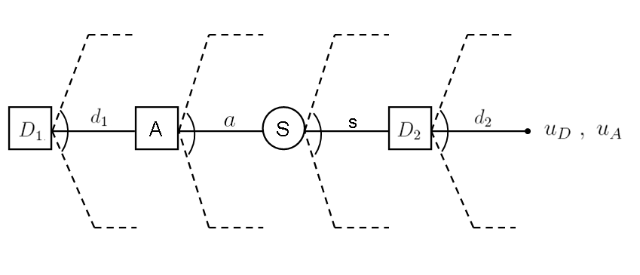
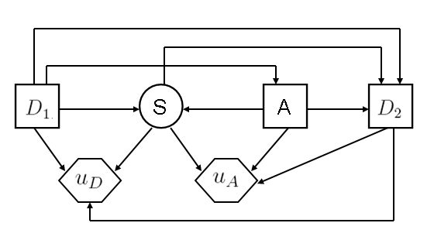
Defend–Attack–Defend model

Slide 6

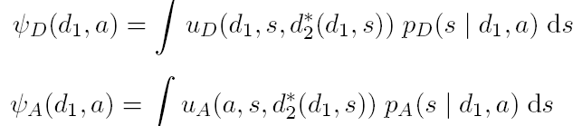


Standard Game Theory Analysis
Under common knowledge of utilities and probs
At node
Expected utilities at node S
Best Attacker’s decision at node A
Best Defender’s decision at node
Solution:

Slide 7
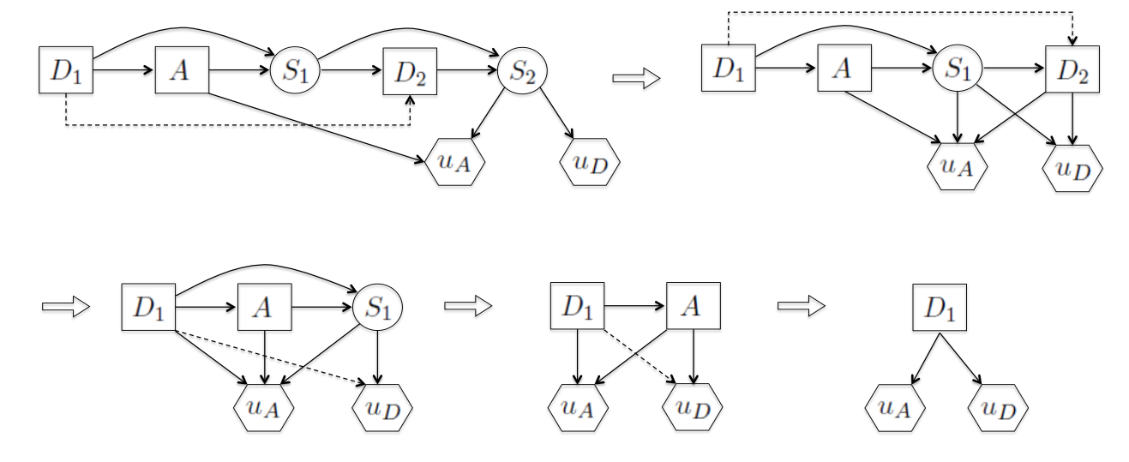
ID reduction algorithm for solving the sequential D-A-D game

Slide 8


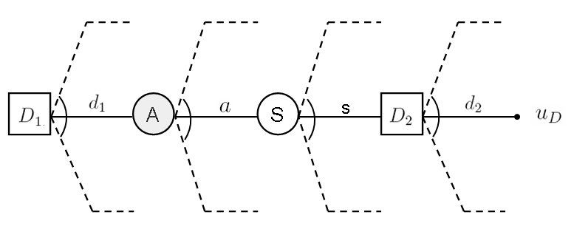

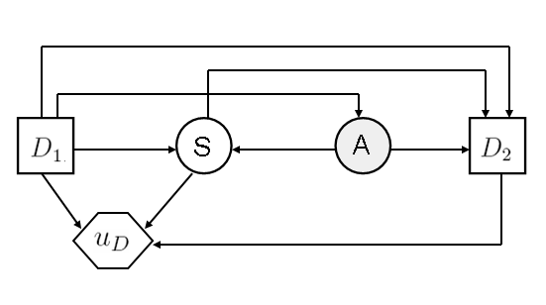
ARA: Supporting the Defender
At node A
At node
?

Slide 9
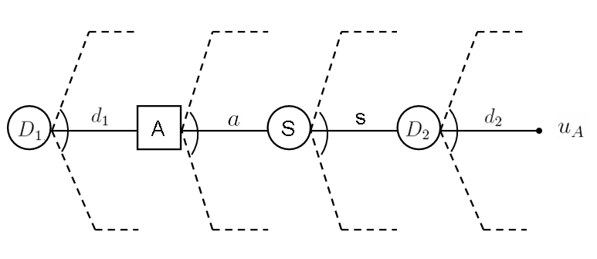
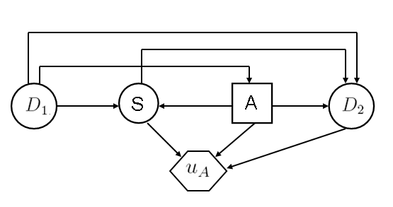



Assessing
Attacker’s problem as seen by the Defender

Slide 10
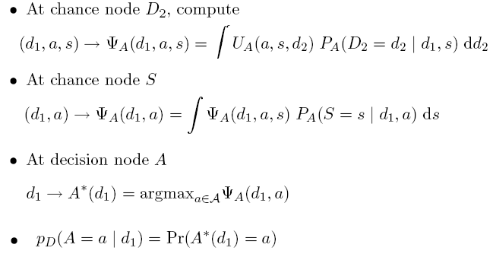
Assessing

Slide 11

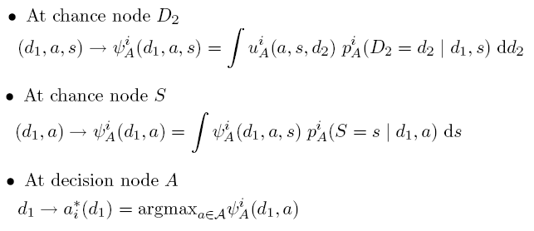

Monte-Carlo approximation of
Drawn
Generate by
Approximate

Slide 12
The assessment of
The Defender may want to exploit information about
how the Attacker analyzes her problem
Hierarchy of decision analysis
  Infinite regress

Slide 13
Urban security resource allocation
Players
  A mayor (Defender)
    aims at protecting multiple city districts
  The mob (Attacker)
    aims at controlling as much value from city districts
Resources to be allocated across the city districts
  Mayor
    Squad car 1
    Foot patrolmen 2
  Mob
    Burglars 2

Slide 14

Urban security resource allocation
  City topology and Mayor’s values
    Districts 1 2 3
  Defend-attack-defend setting
  Mayor chooses an initial assignment of resources across districts
    squad car
    patrolmen
  The mob sees this and allocates his burglars
  Mayor has only time to move the squad car to a neighboring district
    at a cost k = 5 units of value
Payoffs from controlling each district are determined at t = 3
  Who has control of each district at the end of the game
  S_{i} = 1 Mayor, 0 Mob; i = 1,2,3 District
A district provides no value when it is not controlled
t = 1
t = 2
t = 3

Slide 15

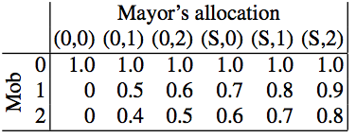
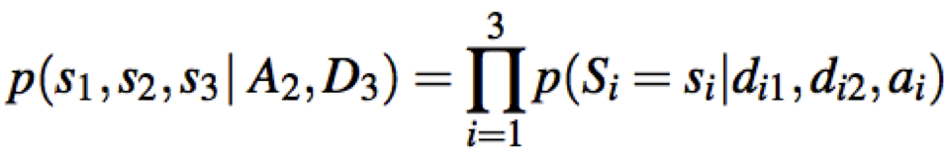
Game theoretic approach
Common knowledge
  Mayor and Mob’s utility and probabilities
Probability that the mayor controls a district

Slide 16



Game theoretic approach
Payoffs from controlling districts (additive)
Mayor and Mob are risk neutral

Slide 17
Multi-Agent Influence Diagram

Slide 18



Backward induction
Mayor best response at t = 3
Mob’s best response at t = 2
Mayor optimal initial allocation at t = 1

Slide 19
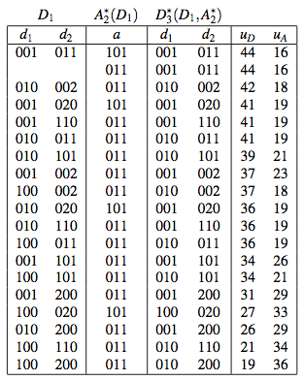
Game Theory solution
GT prediction
1 2 3
City topology and values
Optimal decision path

Slide 20


ARA approach
Weaken common knowledge assumption
  Mayor does not know with certitude
    Mob’s utilities and probabilities
Solve for the mayor (a level-2 thinker)
  Assess predictive probability of Mob’s response
    vs.
  Find Mayors allocation (and re-allocation) of MEU

Slide 21


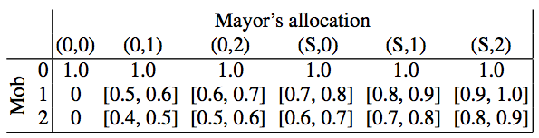
Assessments needed to elicit .
Mob’s valuations for each city district
,
Prob. of controlling a district
  p_{D} = p, but

Slide 22

Assessments needed to elicit .
Mayor level-2 thinker => Mob level-1 thinker
Mob tries to anticipate mayor’s decision
  Mob observes D₁
  Mob sees the mayor solving at t = 3
Mayor needs to assess
  Mob’s estimates of her u_{D} and p_{D}

Slide 23






Mayor assessments of Mob’s estimates for her utility and probability
Mob’s estimate of her district values v
Mob’s estimate of her cost for moving the squad car
Mayor beliefs about the mob’s estimate of her utility
Mayor beliefs about his estimate of her probabilites

Slide 24

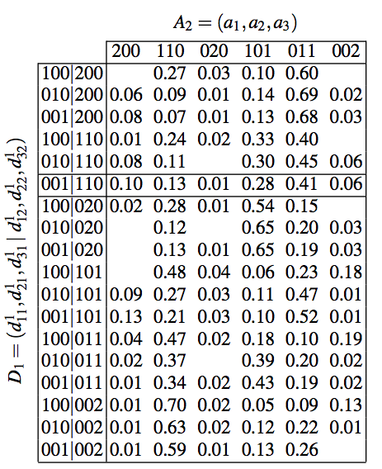

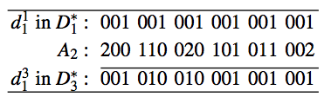
ARA solution
MC estimate of
Mayor optimal allocation
reallocation response

Slide 25

ARA solution
Mob allocates
  Squad car to district of most value
    (0 0 1)
  One patrolman to each of the other two districts
    (1 1 0)
She believes that
  Other burglar allocations are possible
  vs. deterministic GT prediction
Mayor moves squad car to (0 1 0) only when
  A₂ = (1 1 0) or (0 2 0)
  Which she estimates will happened with prob 0.14
GT best response

Slide 26
ARA vs. GT solutions
Three best ARA solutions
  001|110, 100|011, 010|101
cover all districts with some defensive resource
Only one among the 5 best GT solutions does this
  Leaving uncover the district of less value for the mayor
  GT solution predicts that
    the mob will always allocate one of his two burglars
    to the highest value district

Slide 27
Discussion
Are available resources to a player known to the other?
Mob seen as a level-1 thinker who uses GT to find her allocation decision after estimating her u and p
  Other rationality models for the Mob
Sensitivity analysis
  around GT assumption before ARA
  focus elicitation around most relevant ARA assessments

